Slide 1
Access to Justice and the Pacific:
What next?
Cate Sumner, director, Law & Development Partners

Slide 2

SIMPLE
S SHARE
I INCLUSIVE
M MARGINALISED
P PUBLISH with PARTNERS
L LISTEN, LOOK & LEARN
E EVIDENCE

Slide 3
SHARE:
Cook Island indicators
Chief Justices decided upon 15 Cook Island indicators in 2011 covering:
Case management issues
Affordability and Accessibility for court clients
Published procedures for the handling of feedback and complaints
Resources and Transparency

Slide 4
Court transparency 2011-2015

Slide 5
Simple traffic lights
Focuses everyone’s minds….including Chief Justices

Slide 6

Disability Inclusive Reporting
UNESCAP Disability Prevalence in the Pacific (2015)
Solomon Islands 14%
PNG 13.4%
Vanuatu 12.3%
RMI 11.7%
FSM 11%
Tonga 8.7%
Notes:
Source: Govt data to UNESCAP 2015 survey and/or official websites

Slide 7
Disability Inclusive Reporting
With up to 1 in 10 people living with an impairment, Courts need to:
Collect data on clients with different types of impairments,
Report the data in their Annual Reports
Engage with DPOs to develop action plans on appropriate services.

Slide 8
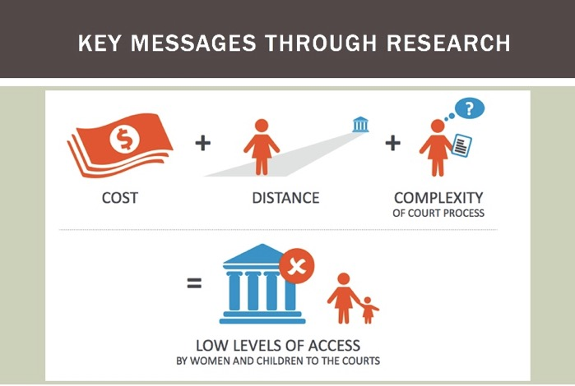
MARGINALISED

Slide 9
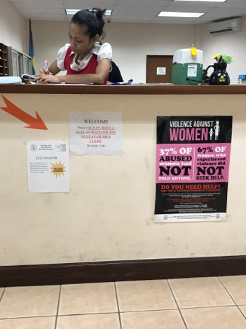
What did we learn? Palau Fee Waiver
Collected data from 2011- Oct 2017 and saw no court fee waiver cases brought.
Role of information to key stakeholders like MLSC
2.5% of civil cases in the COCP now granted a court fee waiver.
50% of child custody cases granted a court fee waiver

Slide 10

publications
Annual Report
Monthly Media Updates
Court User Survey Results
Press Releases
YouTube videos
Knowledge Products
Collaborate across countries/ regions to build skills and knowledge

Slide 11

Publications
Court Annex http://www.fwrm.org.fj/images/A2J/Court-Annex.pdf
ODPP Annex http://www.fwrm.org.fj/images/A2J/DPP-Annex.pdf
Legal Aid Commission Annex http://www.fwrm.org.fj/images/A2J/LAC-annex.pdf
Police Annex http://www.fwrm.org.fj/images/A2J/Police-Annex.pdf

Slide 12

Listen, look & learn
to what counterparts are saying and what they need…
to the most marginalised…

Slide 13
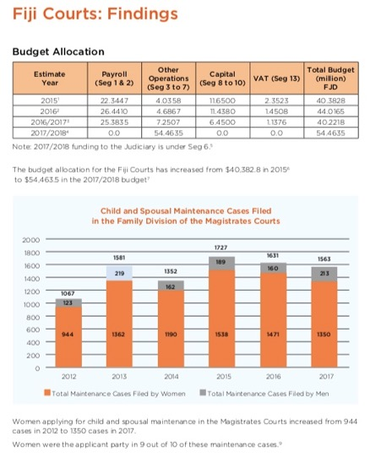
EVIDENCE
Links to:
SHARE
INCLUSIVE
MARGINALISED
PUBLISH with PARTNERS

Slide 14
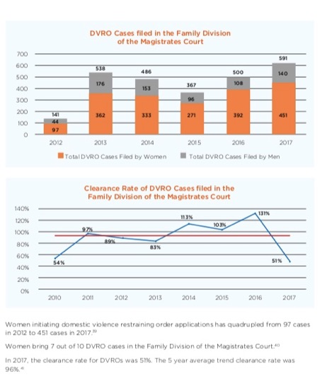

Slide 15
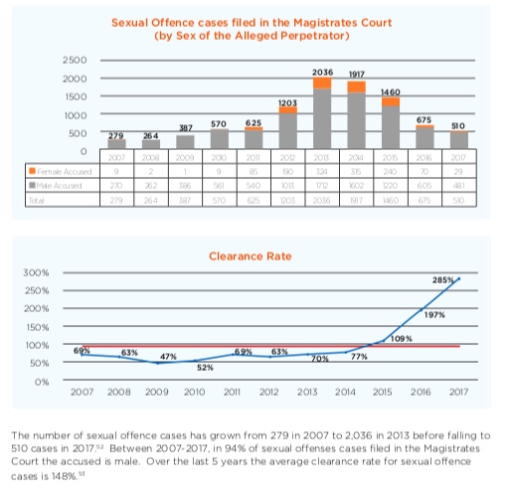

Slide 16

What will transform women’s access to the formal justice system in the next 10 years?

